Slide 1
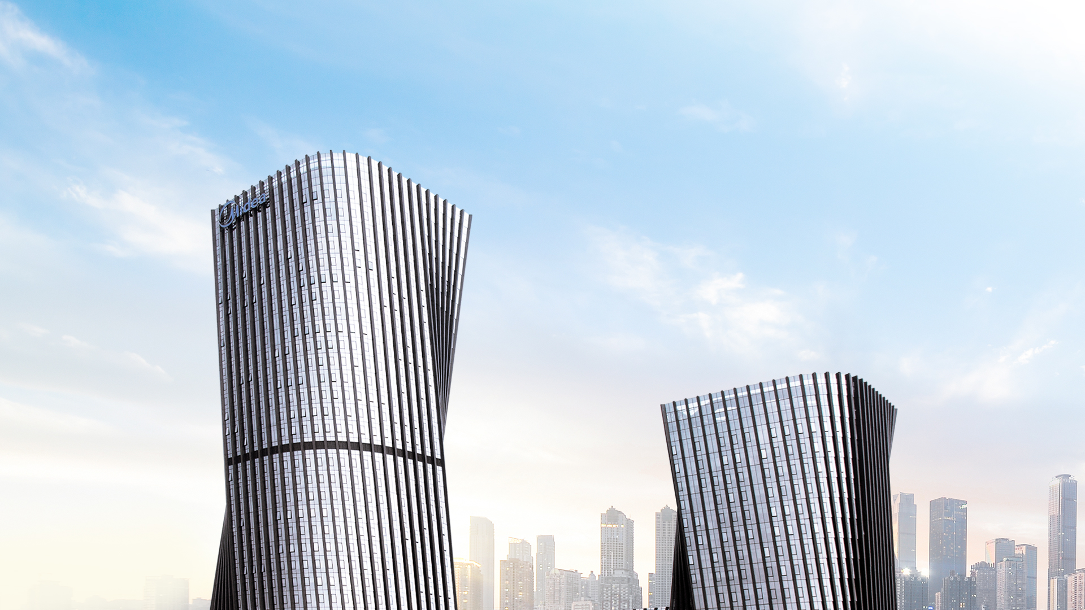
Midea
Building Technologies
Notes:
Ladies and Gentlemen, Good Morning/Afternoon, I am (name) from (dpt.) of Midea Building Technologies Overseas Sales Company, Midea Group.
先生/女士，早上/下午好，我是来自美的集团，楼宇科技事业部海外营销公司XXX部门的XXX。
*本PPT使用财经提供的年度平均汇率7.0558

Slide 2


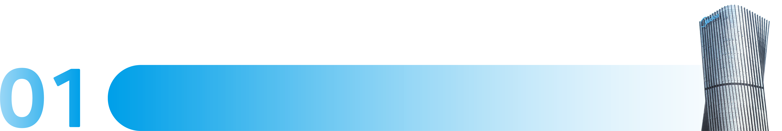



CONTENTS
Midea Group
Midea Building Technologies
Notes:
There are three major sections of the content that we will go through today. The first section is about the brief introduction of Midea Group. Midea Building Technologies business will be demonstrated in the next section. And the final part will be the reference projects that we successfully achieved across the world.
今天介绍的内容分三部分，第一部分简要介绍美的集团的情况；第二部分介绍楼宇科技业务；最后为大家展示在全球成功交付的样板工程。

Slide 3


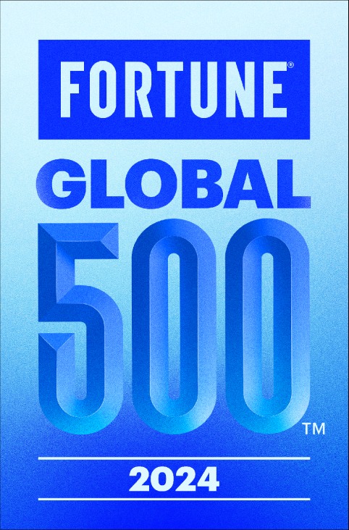


Corporate Snapshot
Worldwide outstanding business summary
＃277
#199
#198
#36
2024 Fortune
Global 500
2023 Forbes Global 2000
Brand Finance 2023 Top 500
Most Valuable Brands
Brand Finance 2023 Top 100
Most Valuable Tech Brands
Total Revenue
Net Profit
Number of Employees
Credit Ratings
US$ 52.96 B
US$ 4.78 B
190K
A/A2/A
2023
2023
2023
S&P /Moody’s /Fitch
Notes:
Let’s start with the introduction of Midea Group. Midea Group has a history of more than 50 years ever since it is founded in 1968. On the current stage we got a hundred and ninety thousand employees globally. In 2023 we achieved a global revenue of US$52.96 billion with a net profit of US$4.78 billion, In 2024, it was ranked 277th on the Fortune Global 500. Besides, we are recognized ranking 199 on the Forbes List of the Top 2000 Global Companies, 198th on the list of Most Valuable Brands issued by Brand Finance 2023 Top 500, and 36th on the Brand Finance's Tech 100 ranking. Meanwhile, Midea’s credit rating is evaluated as grade A and above by the world’s three largest rating agencies.
我们先来介绍一下美的集团。美的集团自1968年成立以来，已经有50多年的历史。现阶段，我们在全球有十九万名员工。2023年，我们实现了529.6亿美元的全球收入和47.8亿美元的净利润，2024年在财富全球500强中排名第277位。此外，我们在《福布斯》全球2000强企业名单中排名第199位，在《品牌财经》2023年500强发布的最具价值品牌名单中排名第198位，在《品牌财经》的科技100强排名中排名第36位。同时，美的的信用评级被世界三大评级机构评估为A级及以上。

Slide 4

Milestones
Successful transition into a multi-category, multi-industry and global operation group.
1999
2020
Started two JVs with Indesit on dishwashers and motors
Acq. of WINONE, entering the elevator sector.
Acq. of HICONICS, strengthening the core components field layout
2008-2013
2004
Series of JVs with Carrier
1992
Acq. of Hualing and Royalstar; started Refrigerators and Laundry business
Acquisition of Chongqing General Chiller
Established Welling Holding and started appliances motors business
2017
2023
2008
Acq. of KUKA & Servotronix
Acq. of Little Swan
Revenue
US$ 52.96 B
Acq. of Clou Electronics
1980
2001
Entered to home appliances market
1998
Acq. of Magnetron from Sanyo
2007
2018
Acq. of Macro Toshiba A/C compressor factory
Introduced commercial A/C to China
Factory In Vietnam
2010
2015-2016
Established 3 JVs with KUKA in China
The scheme of merger of little swan was
authorized by CSRC
2021
Motors business merged into Welling Holding
Acq. of TLSC & Clivet
Acq. of WDM
1968S
1980S
1997
2008
2016
2023
Start-up period
Organic growth in HVAC / SA
Vertical Integration & Horizontal Consolidation in China
Global expansion to international markets
Notes:
This slide is about the developing process and significant milestones of Midea Group. At the very first beginning, Mr. He Xiangjian, the founder of Midea Group, led the native citizens and started up a processing workshop, which started the magnificent journey. In 1980, Midea formally entered the field of home appliance manufacturing. Then from 1992, through the introduction of technology, Midea began to produce core components. Especially in 1998, it started producing air conditioning compressor after a joint venture was formed with Toshiba, Later, entering the new century, Midea accelerated the pace of development acquiring HuaLin in 2004, and entered the refrigerator and washing machine field acquiring the famous brand of washing machine, Little Swan, in 2008. At the same time, Midea also started the process of internationalization, such as the establishment of a joint venture with Carrier, the acquisition of well-known Japanese household appliance brands, as well as the acquisition of Germany's KUKA. In recent years, Midea Group has accelerated the upgrade of to-B business segment and acquired LINVOL Elevator, HICONICS and Clou Electronics etc.
接下来介绍下美的发展历程和重要里程碑。起初，创始人何享健，在中国改革开放以前，带领当地村民成立了加工小作坊，开启了波澜壮阔的发展历程。在1980的时候，美的正式进入家电制造领域。从1992年开始，通过引进技术的方式，开始生产核心零部件，特别是在1998年，与东芝成立合资公司，开始生产空调压缩机。进入了新世纪后，美的加快了发展步伐，在2004年收购了华凌，进入了冰箱和洗衣机领域，在2008年收购了著名洗衣机品牌小天鹅。同时，美的也开启了国际化进程，比如与开利成立合资公司，收购日本知名家电品牌，收购德国KUKA。近年，美的集团加快B端业务板块升级，前后收购了菱王电梯、合康新能、科陆电子等。

Slide 5
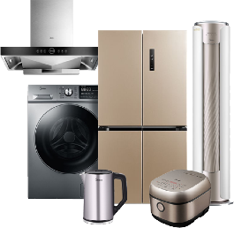
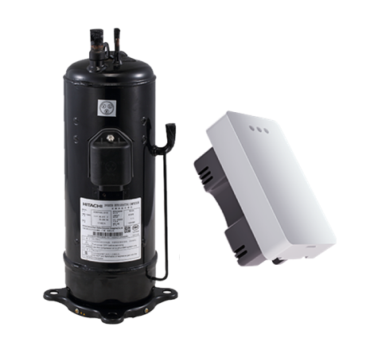
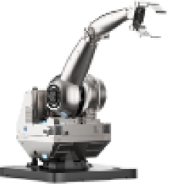
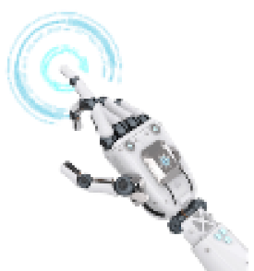
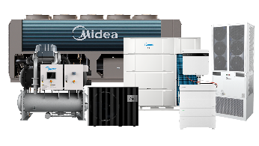








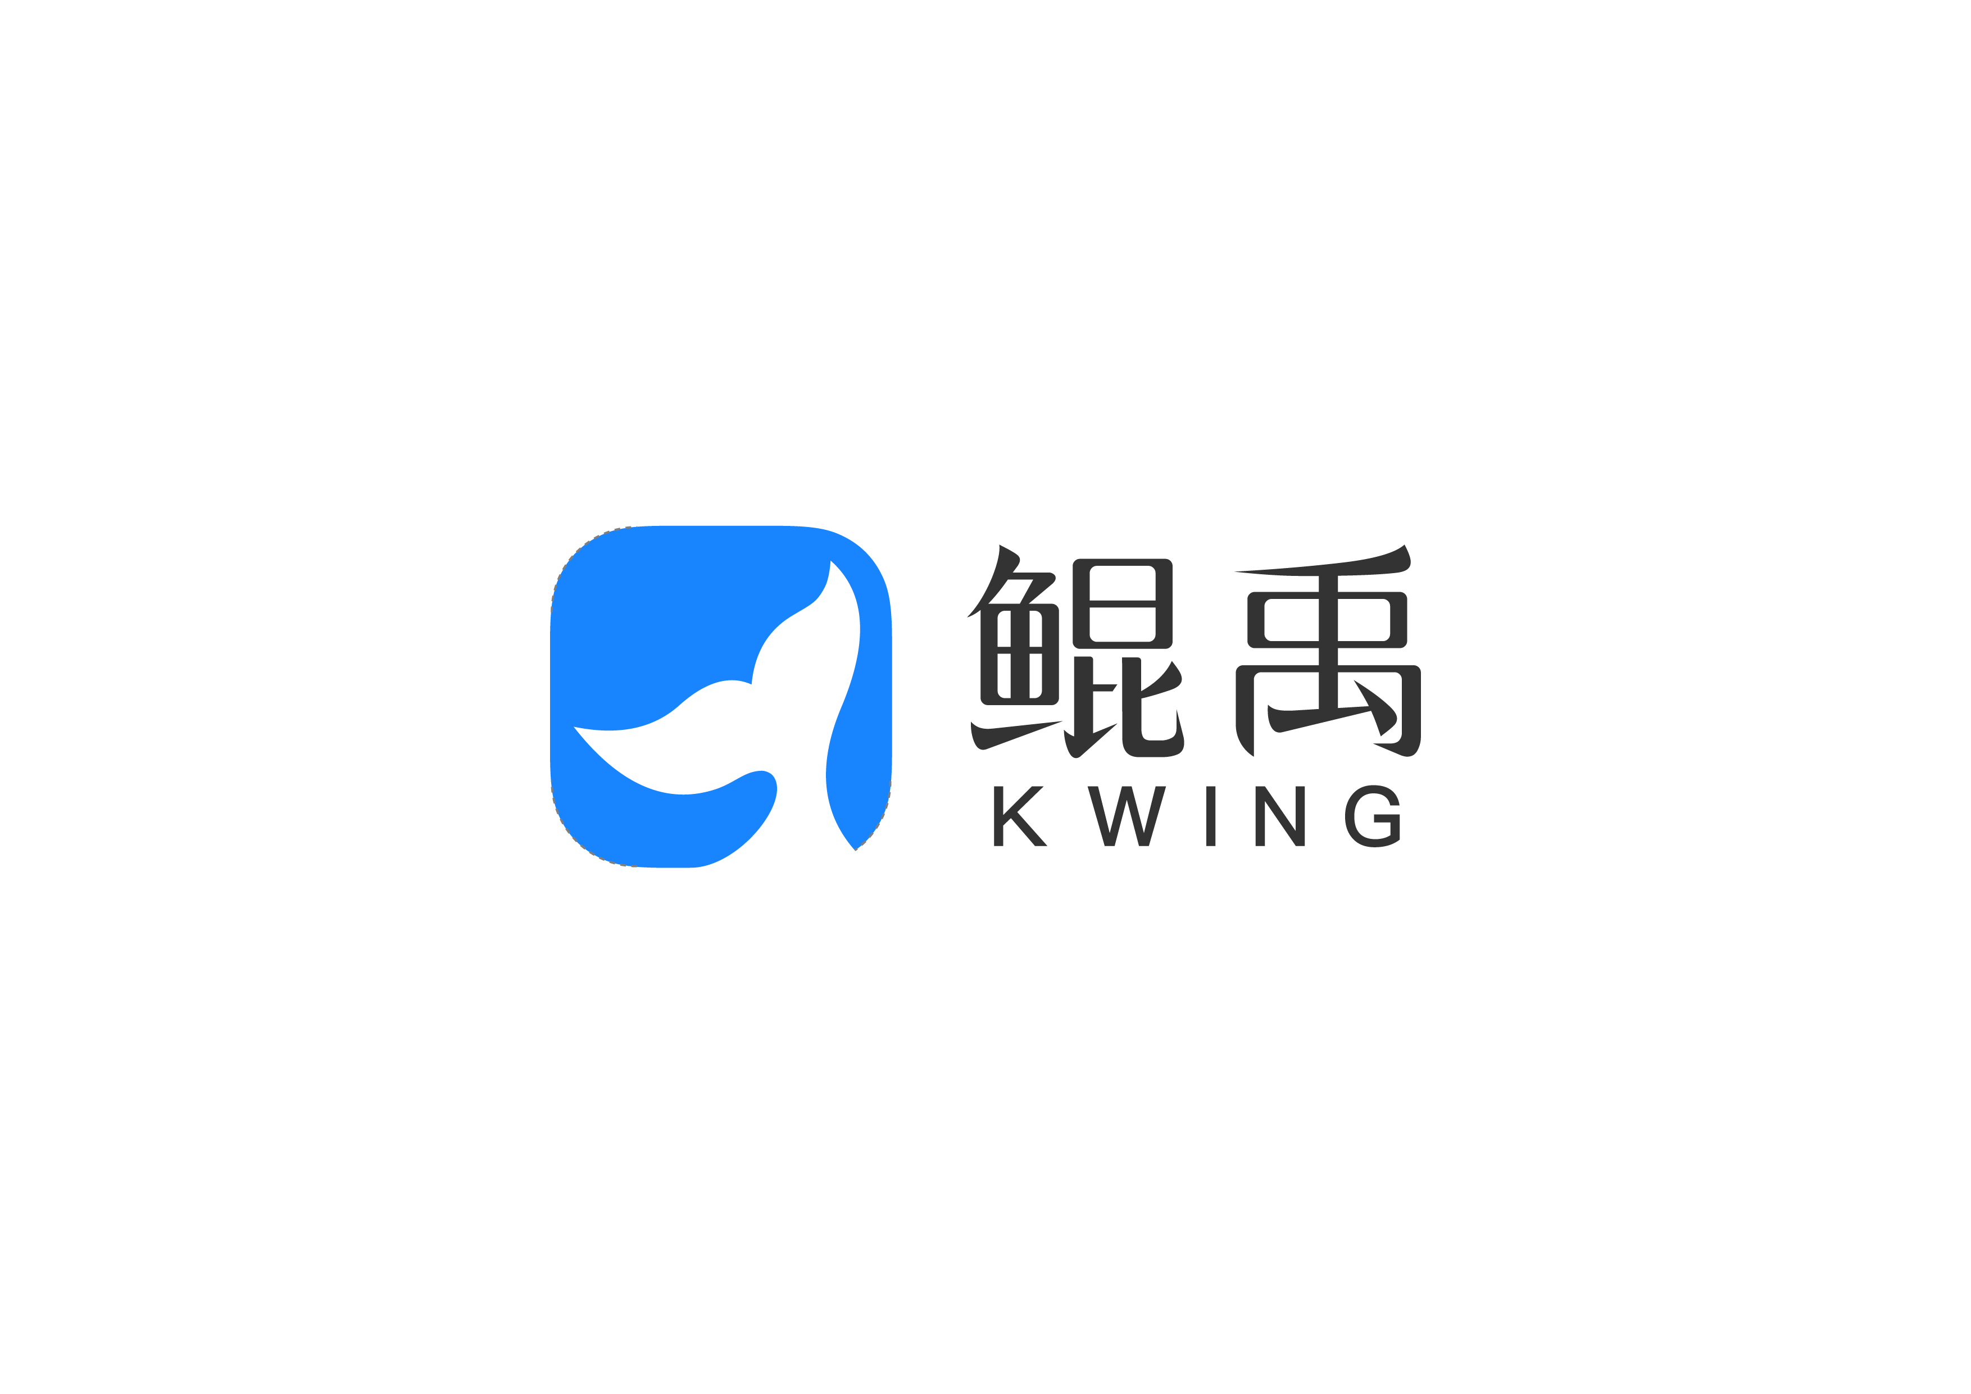
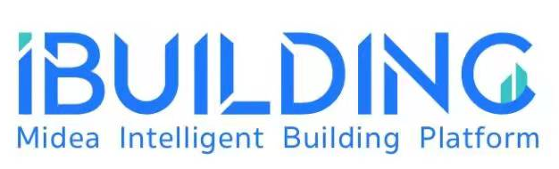







Business Overview
ToC and ToB businesses are driving hand in hand, the innovative business is growing rapidly.
Forming a "1+3+N" business structure.
Digital Innovation Business
Smart Home Business
Industrial Technologies
Building Technologies
Robotics & Automation
Provide customers with the best experience of full home automation service
Provide core components and solutions for household appliances, intelligent transportation, industrial automation, green energy industry
Provide overall solutions and services for building construction
The cornerstone of intelligent manufacturing, automation solutions based on robots
New business service incubated in the course of digital transformation and evolution
Notes:
“Bring great innovations to life”, Midea Group is divided into "1 + 3 + N" business sector, ToC and ToB businesses are driving hand in hand, the innovative business is growing rapidly. "1" refers to the Smart Home Business representing ToC, "3" represents the Industrial Technologies, Building Technologies, Robotics & Automation of ToB business, and "N" represents the Digital Innovation Business. As one of the ToB business segments, Midea Building Technologies is committed to providing overall solutions and services for building construction.
科技尽善，生活尽美，现如今，美的集团整体分为” 1+3+N” 的业务板块，ToC与ToB业务并驾齐驱，创新型业务快速成长。“1”是指代表ToC的智能家居业务，“3”代表ToB业务的 工业技术、楼宇科技、机器人与自动化，以及代表“N”的数字化创新业务。美的楼宇科技作为ToB业务板块之一，致力于为楼宇建筑提供整体解决方案和服务。

Slide 6
Overview
Midea Building Technologies
Overview
Notes:
Next, the emphasis will be placed on the Midea Building Technologies business.
接下来，重点介绍下美的楼宇科技业务。

Slide 7
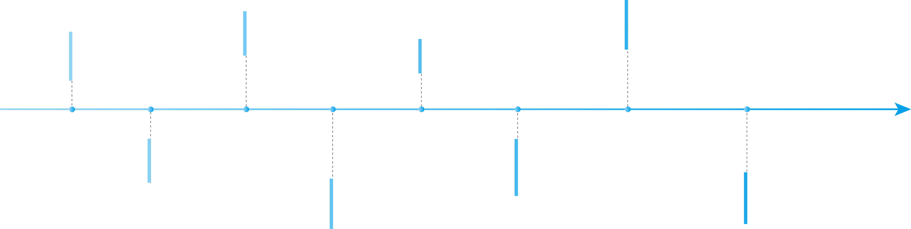
MBT Development
Midea has become a main player in global market
2010
2021
1999
  Hefei Production base setup, expending heating production lines
  Established Building Technology Research Center
2016
  Officially renamed as Midea Building Technologies (MBT)
  Midea CAC established
  Introduced Toshiba-Carrier tech. to launch the 1st VRF in China
  Acquired European famous HVAC company Clivet
FUTURE
2004
2020
  Acquired Chongqing General and entered chiller field
  Acquired LINVOL to enter elevator segment
2022
2015
  Upgraded business strategies & set up Midea KONG Intelligent Building Company
MBT new European production and R&D base foundation stone laid on Feltre Italy.
  JV with Siix in smart control
  JV with Bosch in VRF production
Technology introduced
Business scope increased
Development Innovated
Notes:
MBT was established in 1999 and was called CAC Division at the beginning. In that time, it was the first to produce VRF units in China by introducing Toshiba Carrier technology. In 2004, it was also an important milestone as we acquiried the Chongqing General Factory and entering the field of large chiller. In 2010, the Hefei factory was officially put into operation, mainly producing water heaters. After these 10 years development, we had become the most complete brand in the HVAC industry. The second decade, from 2010 to 2020, is a decade of diversification and internationalization of our business. We have successively established joint ventures with Bosch and Six and also cooperated with other international brands. In 2016, we acquired CLIVET, a famous Italian central air-conditioning enterprise, to further optimize our global layout. The third decade begins in 2020, which is the key node to officially start our transformation to building technology: in August 2020, we acquired Linvol Elevator, formally entered the elevator field, established Midea KONG Intelligent Building Company in the same year, established Midea Building Technology Institute in April 2021, and officially upgraded to Midea Building Technologies Division in September of the same year. This decade will be a decade for us to accelerate the transformation of building technology. Also we would like to highlight that in 2022, our European production and R & D base foundation stone laid in Feltre Italy, strengthening the strategic layout of Europe.
楼宇科技事业部成立于1999年，成立之初叫中央空调事业部；当年就通过引入东芝开利技术，最早在中国生产多联机。2004年也是发展历程中的一个重要里程碑，收购了重庆通用工厂，进入了大水机领域。在2010年合肥工厂正式投产，主要生产热水机。经过大约10年的发展，成为暖通系统行业中产品系列最齐全的品牌。第二个十年，从2010年到2020年，是我们业务多元化及国际化的十年，先后与西门子、博世、希克斯分别成立合资公司，在不同领域展开合作；在2016年，收购了意大利著名中央空调企业CLIVET，进一步优化全球布局。第三个十年开始于2020年，是正式开启我们向楼宇科技转型的关键节点：在2020年8月，收购了菱王电梯，正式进入电梯领域，同年成立上海美控公司，2021年4月成立美的楼宇科技研究院，同年9月，我们正式升级为美的楼宇科技，向行业传递我们在楼宇领域布局及拓展的决心和信心，这十年将是我们加速转型楼宇科技的十年。在2022年，我们的欧洲生产和研发基地奠基于Feltre意大利，加强欧洲战略布局。

Slide 8







Overall Overseas Strategic Layout Planning
7 Production Bases
Hefei Base
DX product & Heat pump
Chongqing Base
Chiller & Terminals
Shunde Base
DX product & Heat pump
Nanhai Base
Elevator
Jingzhou Base
DX product & Heat pump
Italy Base
Applied + Heat pump new production line
Thailand Base
US products (mainly)
6 R&D Centers
European R&D Centre
Japan R&D Centre
Shanghai R&D Centre
Hangzhou R&D Centre
Foshan R&D Centre
Chongqing R&D Centre
*Temporarily excluding Arbonia

Slide 9









To B Globalizations Overseas Organizational Structure
17 Representative Offices
U.S.A (Boston, Charlotte)
Central America (Mexico)
South America (Brazil)
Australia and New Zealand
Western Europe (Spain)
Eastern Europe (Hungary)
Central European (Greece)
Philippines/ Thailand/ Malaysia/ Vietnam/ Indonesia
UAE/ Caucasus /North Africa (Egypt)/ East west south africa (The Republic of South Africa)/ West Asia (Iraq)
3 Regional Offices
Asia & Africa - Dubai
Europe - Italy
Latin America - Mexico
8 Branches
Italy/ France/ Germany/ Britain/Croatia/ Russia/ India/ UAE

Slide 10


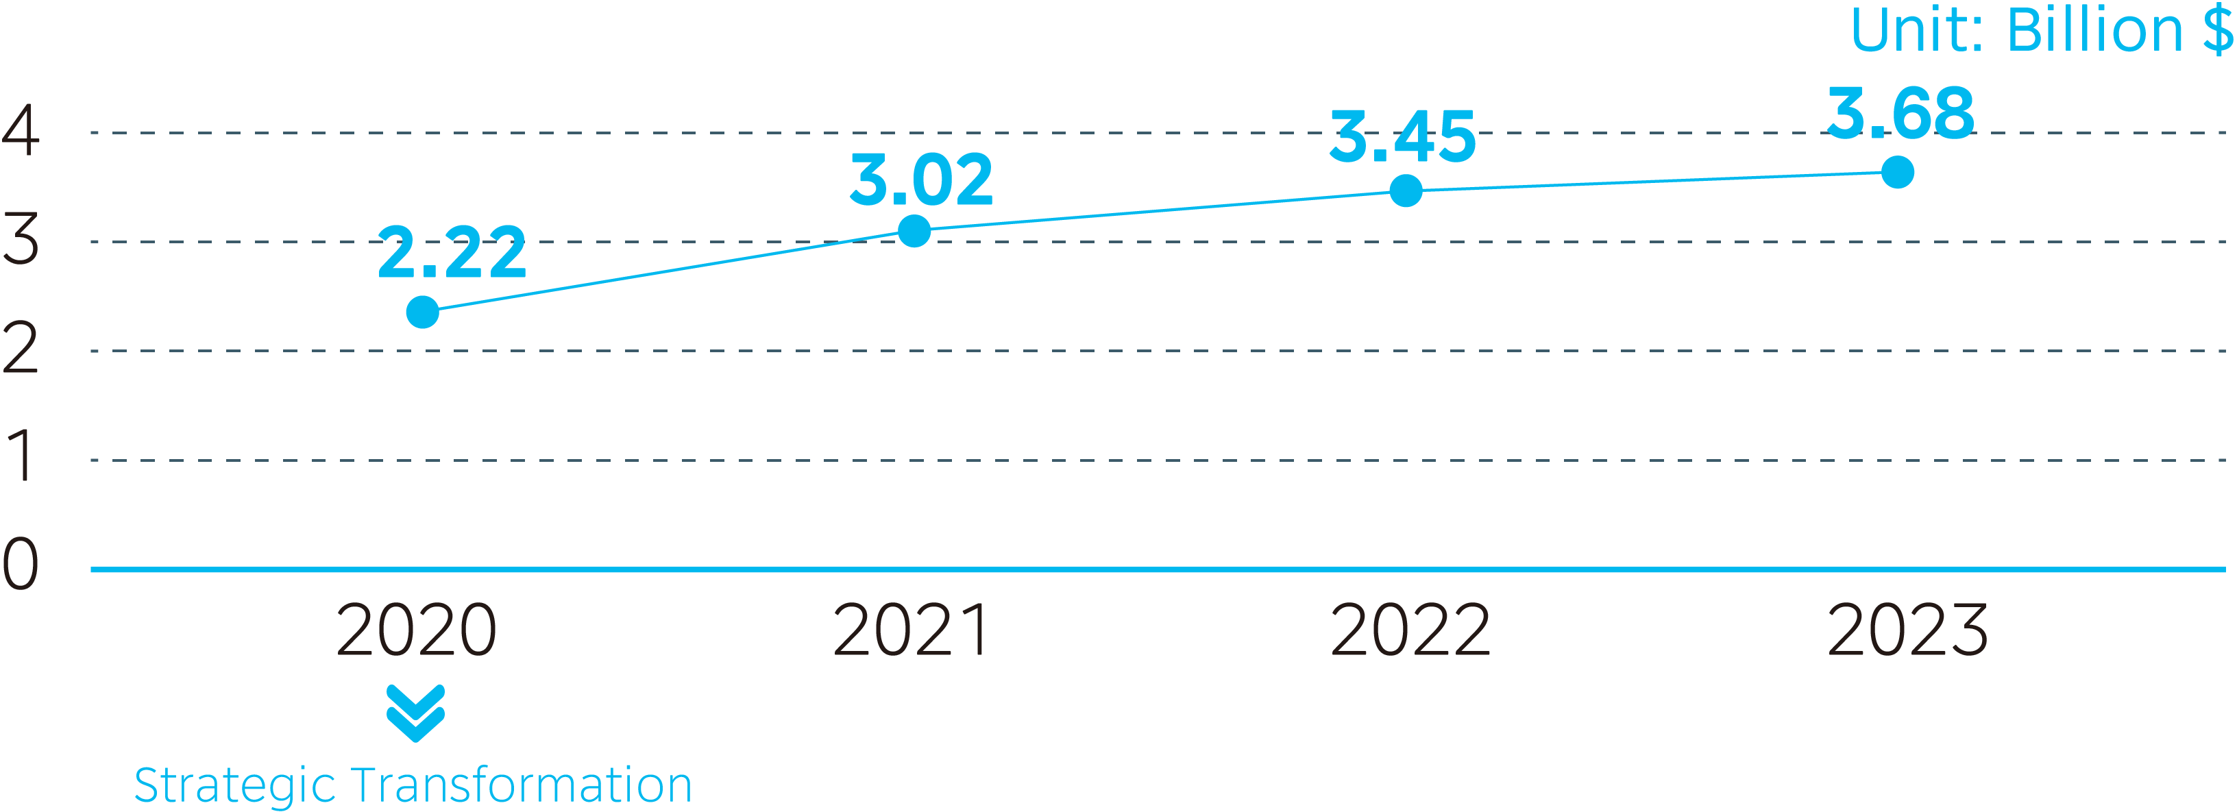
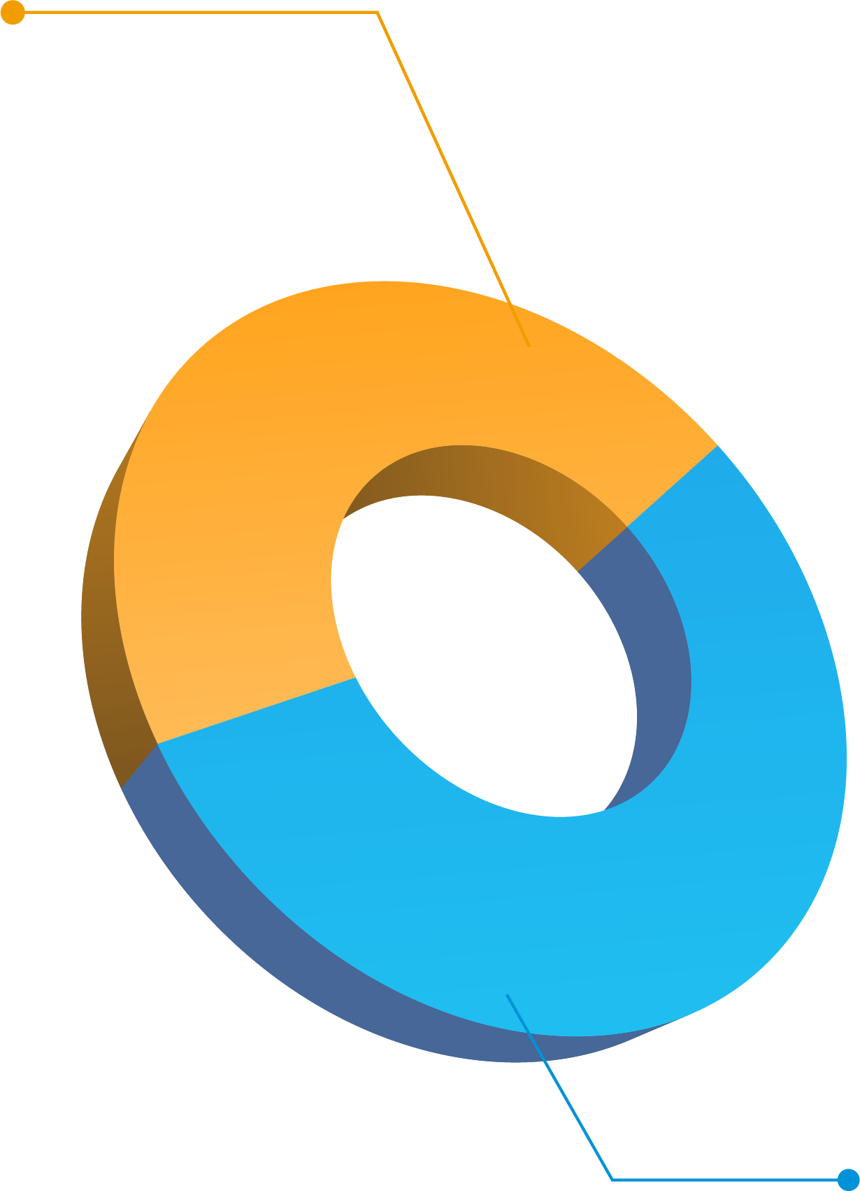


MBT Sales Revenue
MBT achieved fast growth in the past years
MBT Sales Revenue of 2023
MBT Overall Sales Revenue
47%
MBT OSC in 2023
US$1.74B
MBT OSC Sales Proportion
53%
42%
47%
29%
29%
Domestic Market in 2023
US$1.94B
* Including Clivet & Elevators sales
2020
2021
2022
2023
Notes:
Midea Building Technologies business has maintained a steady increasing trend of development. In 2020, MBT continued a very advanced strategic business transformation, placing the emphasis in comprehensive to-B solutions. Till 2023, sales revenue of MBT reached 3.68 billion dollars, of which overseas sales company’s receivable achieved 1.95 billion US dollars.
楼宇科技业务一直保持了稳健的发展。在2020年，楼宇科技事业部持续了前瞻性的业务战略转型，剥离to C业务，调整为完全的to B端解决方案。至2023年，事业部整体实现营收36.8亿美元，其中海外营销公司营业收入达到19.4亿美元。

Slide 11

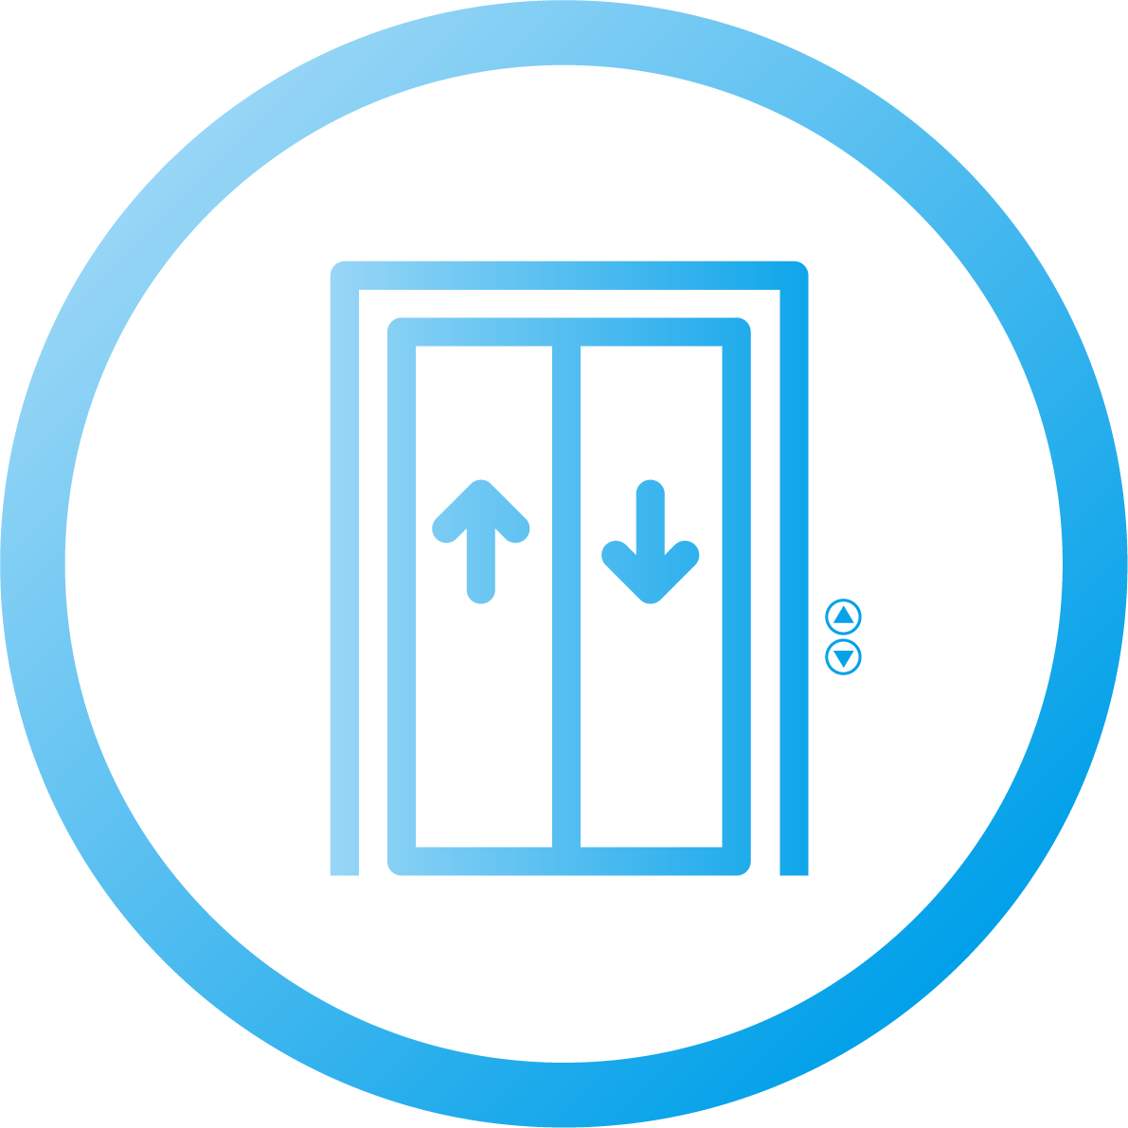






Business Segment –Building Technologies
Provide overall solutions and services for building construction
HVAC
Elevator
Building Intelligence
Energy Management
Committed to providing users with intelligent, digital, low carbon overall building solution

Slide 12

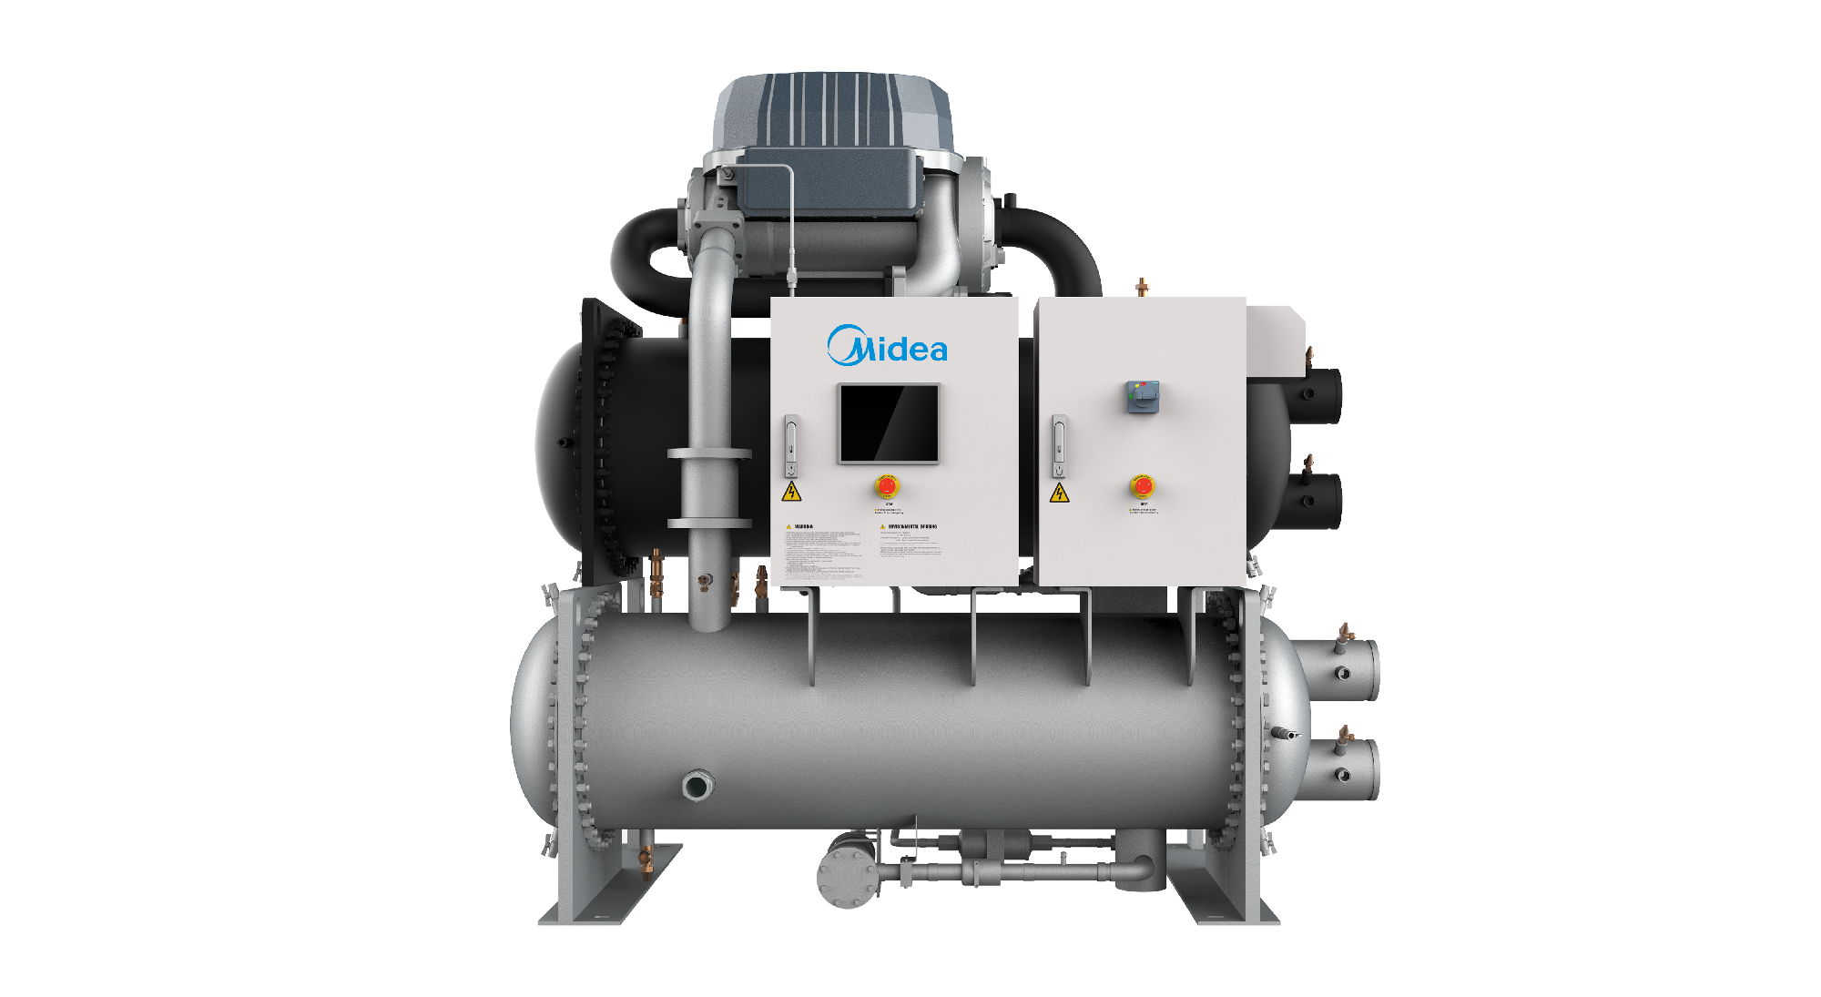
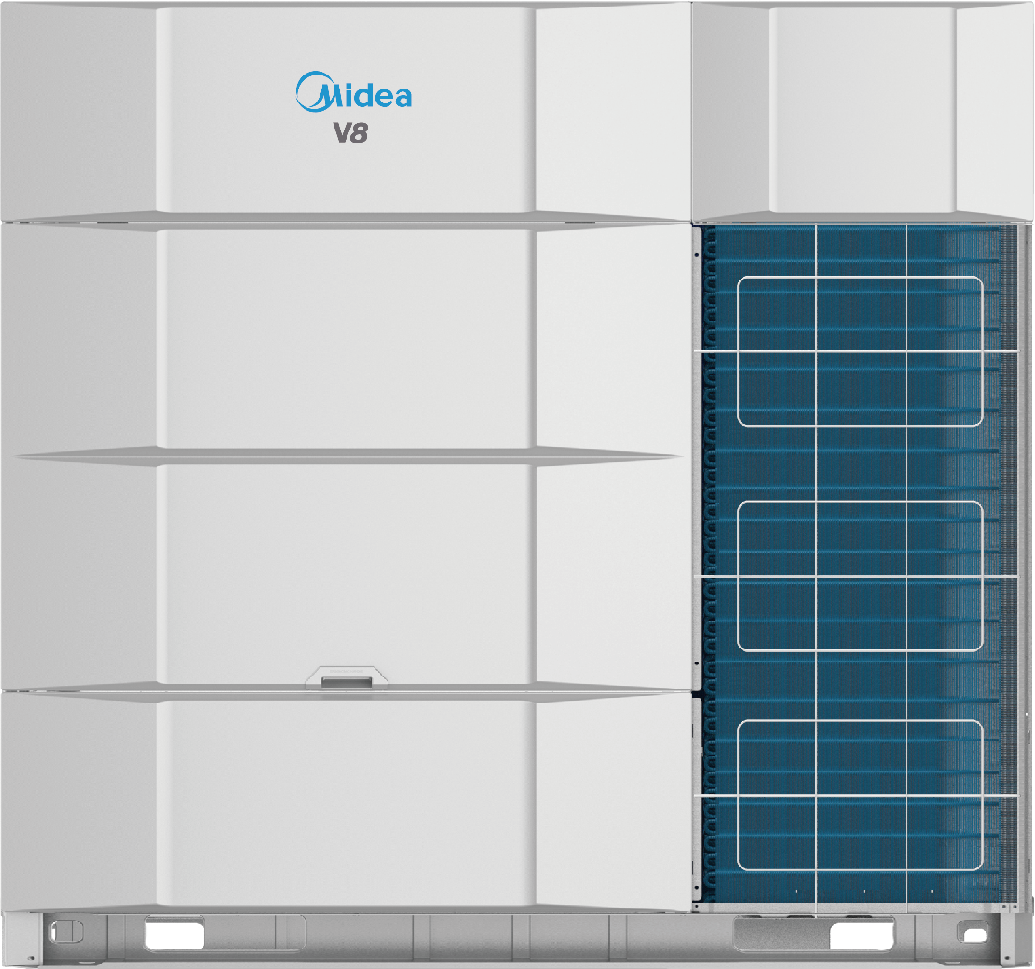
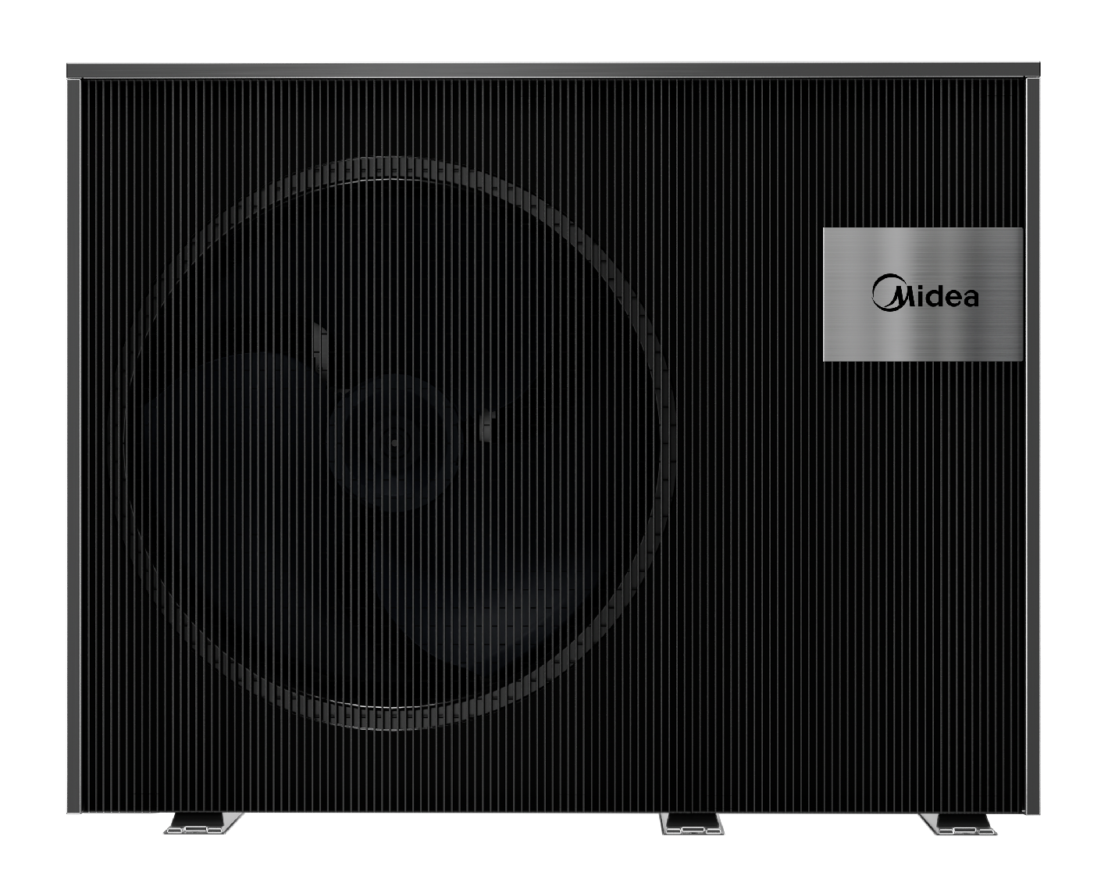
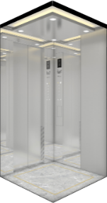
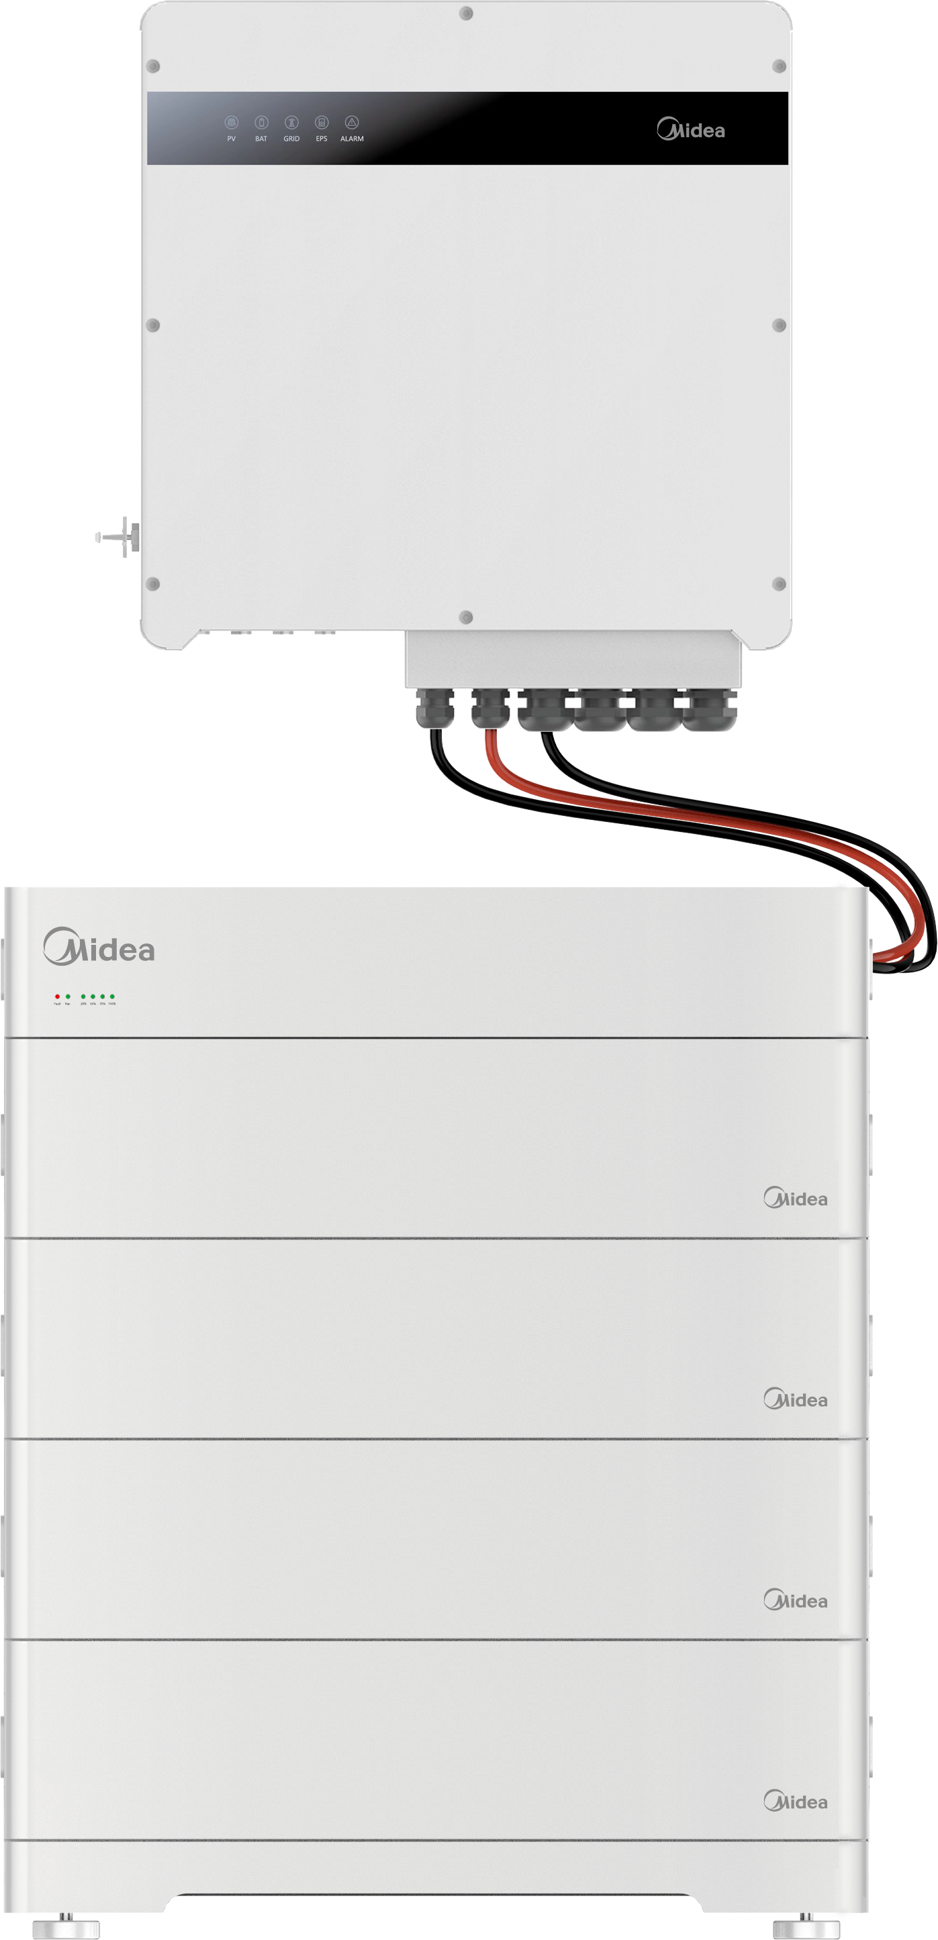
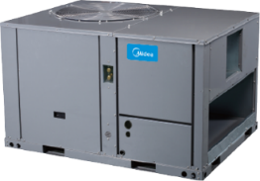
MBT Product Lineup
Provide the most comprehensive HVAC solutions for any applications
Chiller & Terminals Product Line
VRF Product Line
ATW Heat Pump Product Line
Scroll
Screw
Centrifugal
FCU & AHU & MAHU
Mini
Heat pump
Heat recovery
Water cooled
Cooling only
Mthermal
Commercial
Swimming Pool
DX Product Line
Elevator Product Line
Energy Management
Rooftops
Large split
US ducted
Elevator
Escalator
Walkway
Energy Storage Systems
Notes:
Midea Building Technologies has the most complete product line in the industry, including Chiller, VRF, Heat Pump, DX Product line and elevator product line. Chiller product line includes water-cooled screw chiller, air-cooled screw unit, VFD Direct-Drive centrifugal chiller, magnetic centrifugal chiller, and terminal products. The VRF product line includes, large MAXI VRF and MINI VRF, heat recovery VRF, and water cooled VRF. Heat Pump product line include commercial water heater, and residential air source water heater. DX Product line includes US duct and Rooftop Packaged Unit. Elevator product line includes elevator, escalator, and walkway etc. Energy Usage Solution includes Electrical Storage Systems.
美的楼宇科技拥有业界最全的产品线，包含大水机、多联机、热水机、单元机和电梯。大水机包含水冷螺杆机组，风冷螺杆机组，变频直驱离心机、磁悬浮离心机和水机末端产品。多联机产品线包含大多联机、MINI VRF，带有热回收功能的多联机，以及水源多联机产品。热水机包含商用热水机，和家用空气能热水机。单元机包含美式风管机、屋顶机等产品。电梯包含各式直梯和扶梯等,能源解决方案则包含ESS产品。

Slide 13


THANKS
Notes:
Ladies and Gentlemen, Good Morning/Afternoon,

